Slide 1
I399 Web Design
Lab 4

Slide 2
You may work together or on your own today, but please turn in your own document to Canvas at the end of class.

Slide 3
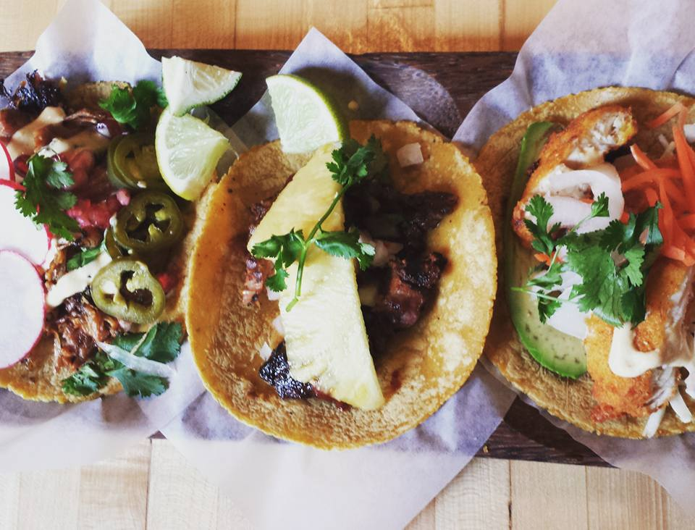
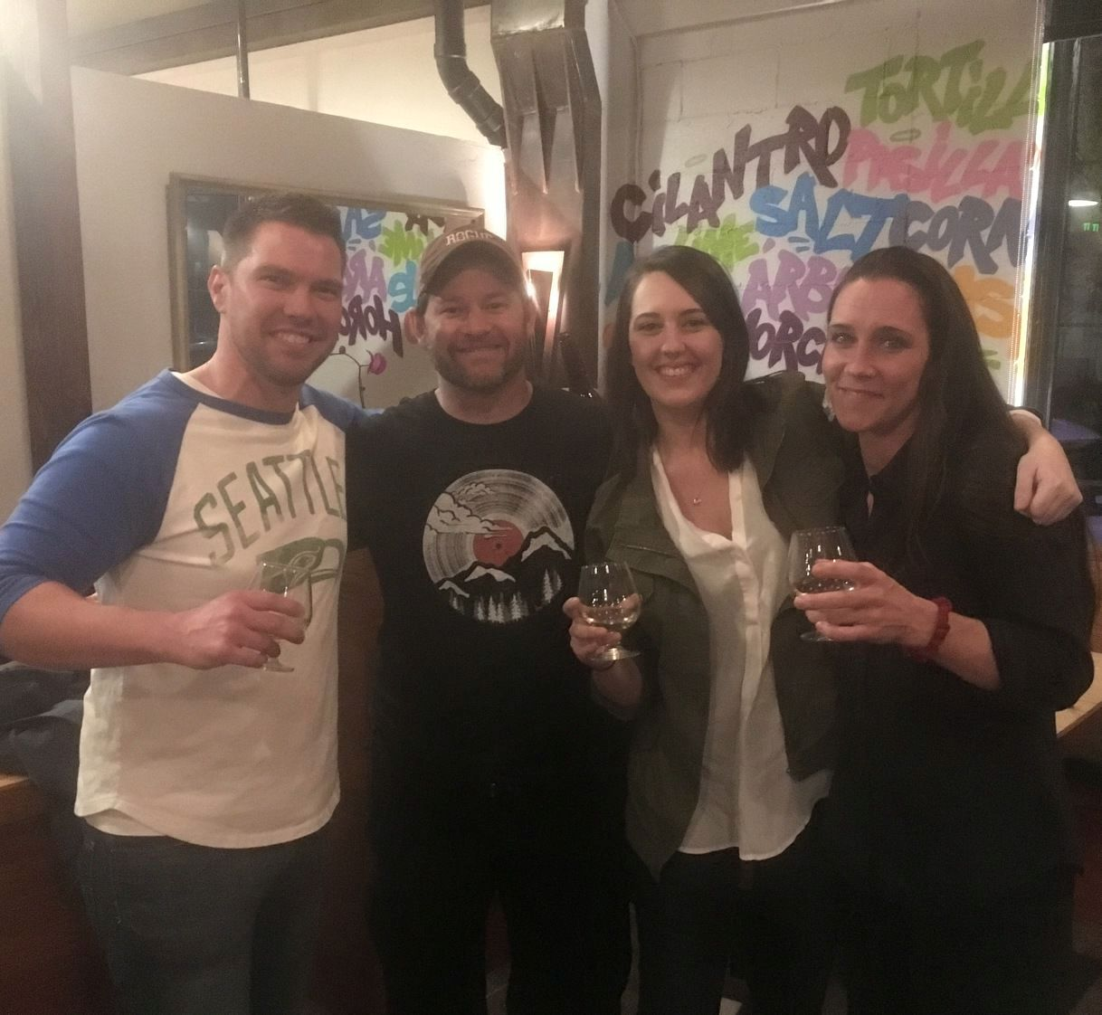

Can you design a website for us?
Hi, we’re Jason and John, and we just opened a new restaurant called “Taco Vino” in Corvallis, Oregon.
The food is 100% gluten free and we’re using tacos as the vehicle for some of the most delicious pairings you’ve ever tasted.
Our restaurant has a lot of natural light, wood tables and an open floor plan. It holds maybe 50 people or so.

Slide 4
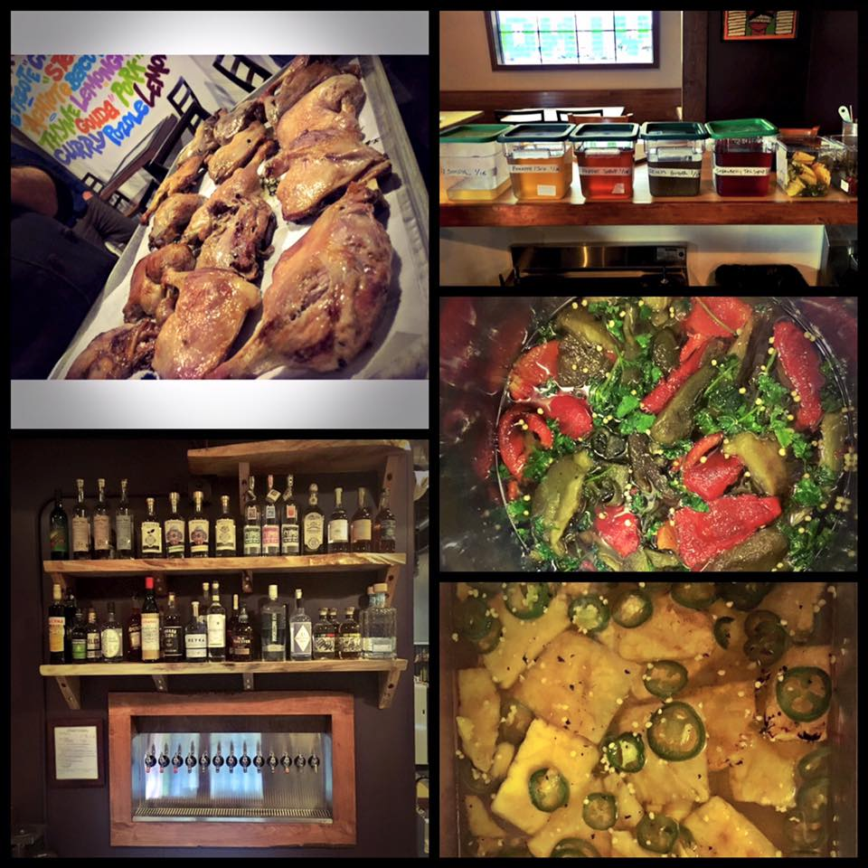

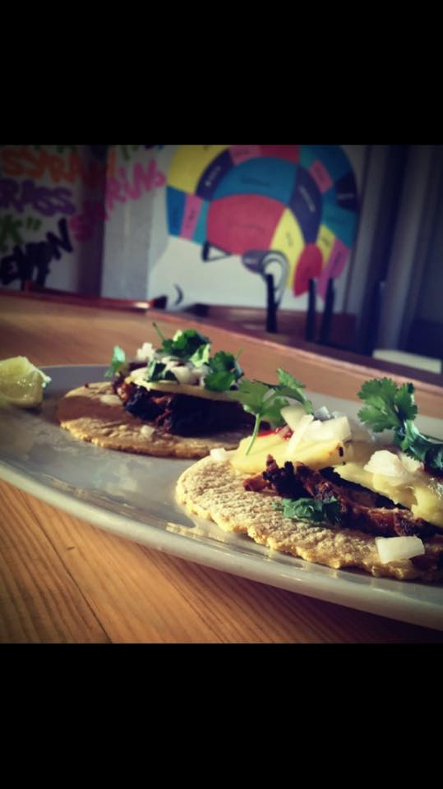
Create a Style Tile for a Client
Inspiration
Notes:
https://www.tacovinocorvallis.com/

Slide 5
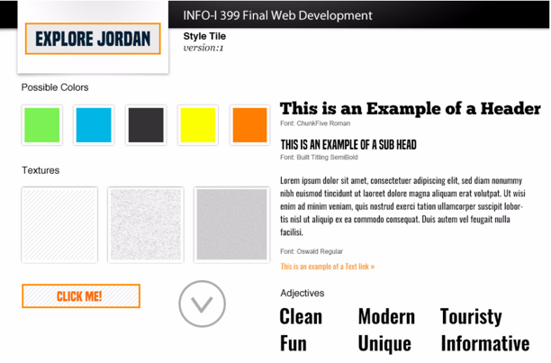
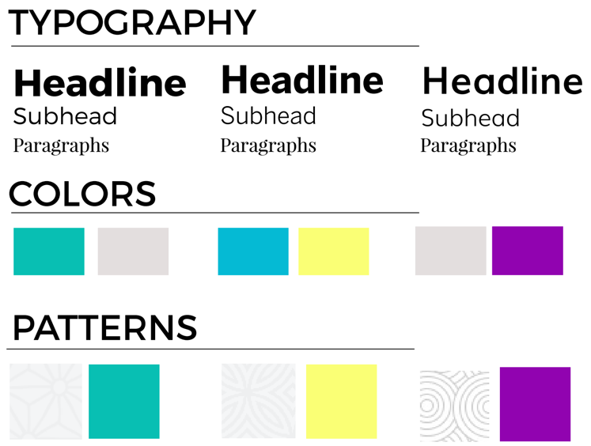
Today we’re going to create a style tile.
A collection of ideas on the design, separated from the content and layout.
The idea is to match these choices to the tone of the design and what would meet audience expectations.
By making these choices, we can discuss what we like / don’t like without messing with coding or mock-ups. (Though you may want to do so later…)

Slide 6
Directions
Open the starter file in Word. If you feel more comfortable working in Adobe, please feel free to do so. Also reference our Online Resources for color and typography inspiration.
Read through the adjectives (“descriptors”) describing the look & feel of the website your client would like and use these to inform your design decisions.
Select a color scheme (feel free to use color.adobe.com like we did in class) - assume black / white are already (or can be) part of your color choices - either change out the boxes included, or do a partial screenshot
https://support.apple.com/en-us/HT201361 - how to take a screenshot (Mac)

Slide 7
Directions
Select one, two or three typefaces - Do your best to represent the typeface within Word - You might find a screenshot is the easiest way - We’ll mostly use Google Webfonts (and will learn to use this next week) - Use the links below (from Online Resources) to help you choose
http://fontpair.co/
http://www.mrmcguire.com/10-useful-google-font-combinations-for-your-next-site/
http://femmebot.github.io/google-type/
https://fonts.google.com/

Slide 8
Directions
Choose a few textures, patterns or graphical elements to include - You’ll need to use images off the web for this - Copy/paste or screenshot to include in your document - We’ll discuss basic Copyright issues with images next week, but as you aren’t publishing these on the internet, or making money from their use, it is okay to use photos you don’t own for school projects

Slide 9
Finished?
Upload your Style Tile document to Lab 4 on Canvas.

